Slide 1
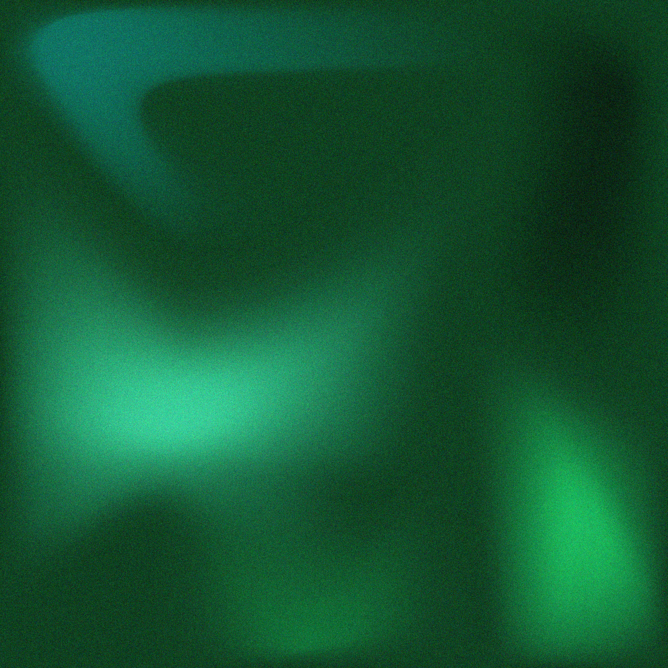

PRESENTED BY SOO JIN AE
FOR LICERIA & CO.
BORCELLE STUDIO
Project Brainstorm
FOR WEBSITE PROJECT

Slide 2

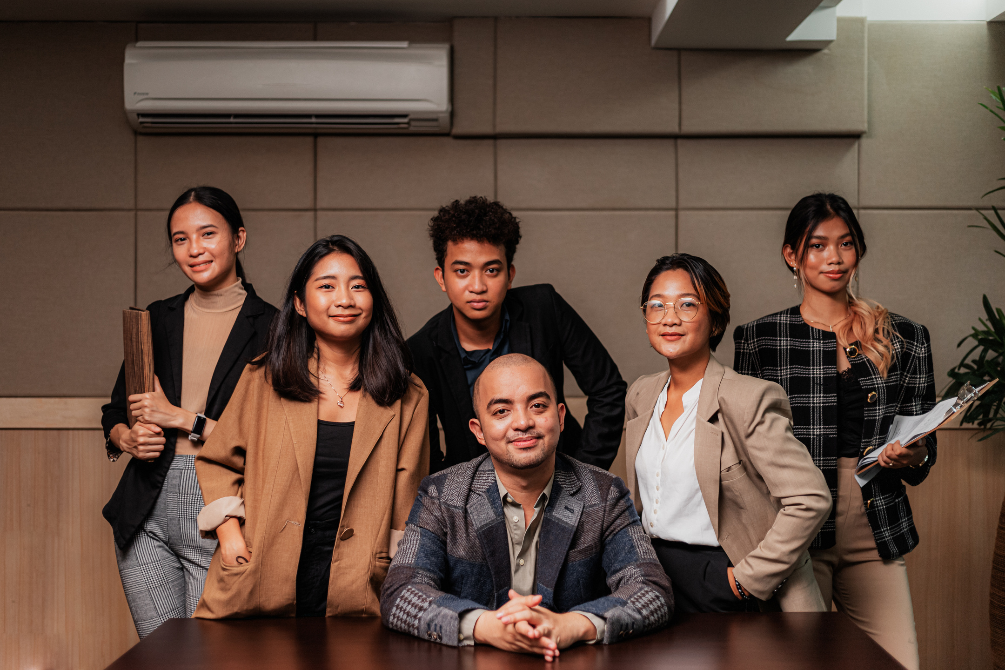
Hello, everyone!
INTRODUCTION
PLEASED TO MEET YOU ALL!
I'M SOO JIN AE. A GRAPHIC DESIGNER FROM BORCELLE STUDIO, AND TODAY I'M EXCITED TO WALK YOU THROUGH MY DESIGN PROJECT BRAINSTORMING PROCESS. LET'S DIVE RIGHT IN!

Slide 3


Today's Plan
AGENDA
PROJECT OVERVIEW
BRAINSTORM
SUMMARY
We're diving into a team design project, still in the brainstorming phase, where we're refining the initial concept.
What exciting elements can we add to this project to make it more interesting and practical?
We'll wrap up our brainstorming session and discuss how we can take these ideas forward.

Slide 4
MOTTO
TODAY'S MOTTO
Our journey towards design excellence is all about unlocking potential through collaboration.

Slide 5

Project Overview
OVERVIEW
This project revolves around the art of crafting a website that serves as a dynamic and user-friendly hub for Liceria & Co., making their online presence as versatile as their business.
DESIGN PROGRESS
CREATIVE BRAINSTORM
We can see the preview of the project’s design progress below. We are currently in the creative development stage.
DISCOVERY PHASE
CREATIVE DEVELOPMENT
IDEA BRAINSTORM

Slide 6
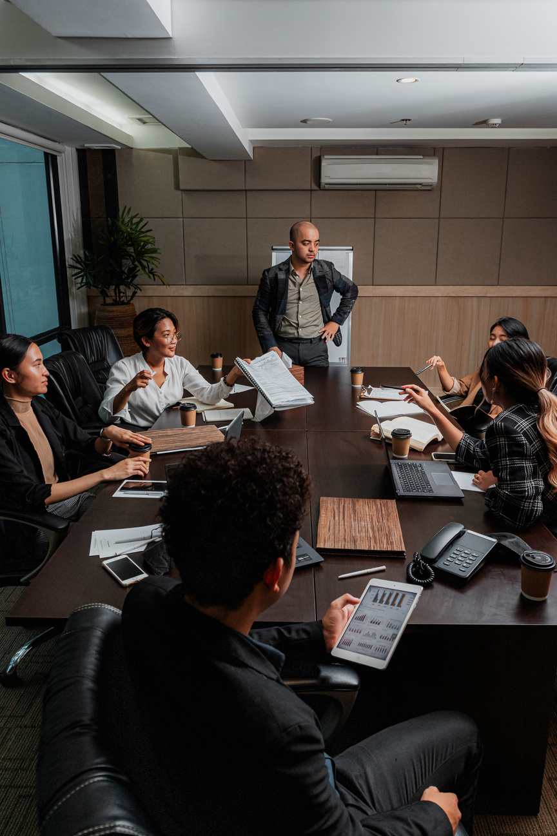
BRAINSTORM
MAIN IDEA
NEW IDEA
Our goal is to design a website that embodies ease of use and adaptability. We want it to be an informative digital space for all users.
Applying recent design trends into Larana, Inc.'s website to enhance its visual appeal and usability for user experience
POTENTIAL IDEA
BACKUP IDEA
Let’s explore out collective creativity to shape this project into something that resonates with the purpose of the project
Let's consider unconventional approaches to website branding. This could be an innovative solutions that perfectly suit Larana, Inc.
Brainstorm

Slide 7

NEXT PHASE
CREATION PHASE
In this phase, we will strategically develop and implement the website branding concepts generated during our brainstorming session.
TESTING AND REFINEMENT
Once the initial design is in place, we'll conduct rigorous testing to ensure that the website not only meets but exceeds our standards for usability and adaptability.
The Next Step
PROJECT LAUNCH PREPARATION
After diligent work, we'll prepare for the project launch, gearing up to introduce your designs to the real world.

Slide 8
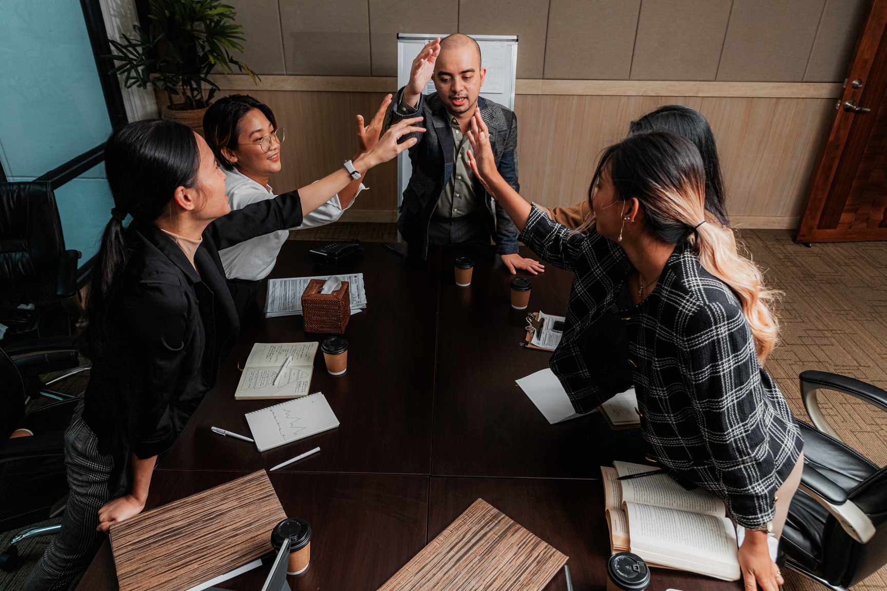
RECAP
Summary
INTRODUCTION
  BRAINSTORM
This recaps the introduction session, which introduces the project in general and how it works.
  COMPILATION
The brainstorming concludes that the new ideas will be considered further and the findings will be revealed.
Compiling all of the concepts into a single file in preparation for the discussion session.

Slide 9
DISCUSSION
YOUR PARTICIPATION MATTERS!
Let's start the discussion!

Slide 10
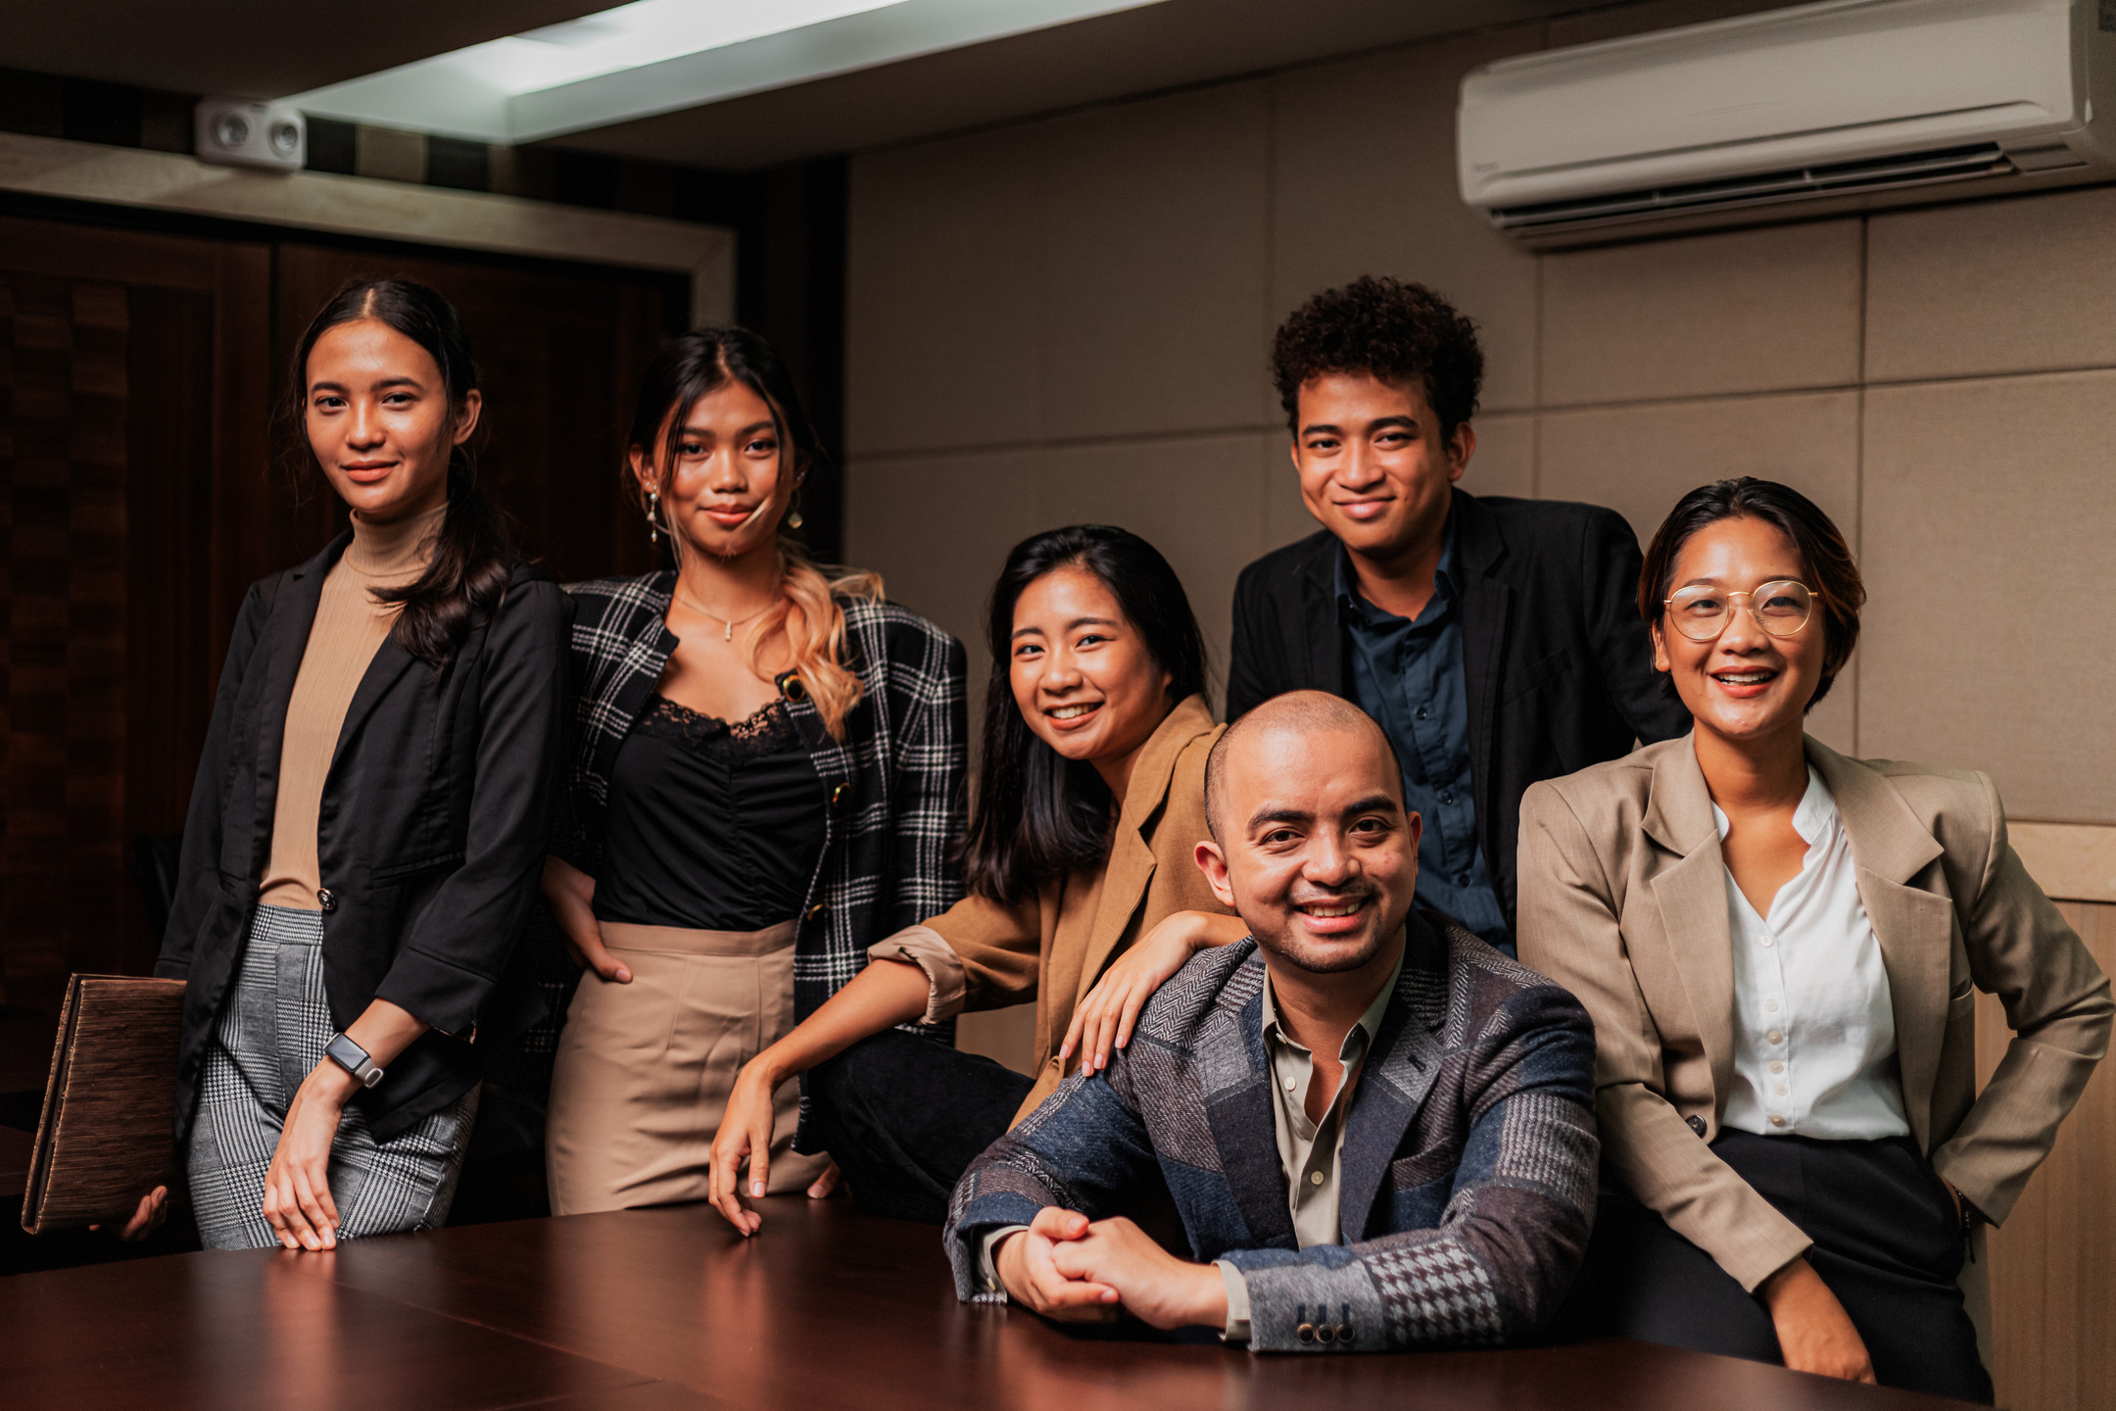
BORCELLE STUDIO
We appreciate your enthusiasm, and We look forward to our next session on Monday. Keep those ideas flowing, and we'll make this project truly outstanding!
Thank you for your time!
I WILL SEE YOU NEXT TIME!

